Slide 1
From decolonisation to locally-led development: repoliticising the agenda
Dr. Lata Narayanaswamy
Associate Professor in the Politics of Global Development
University of Leeds, UK
Wednesday 21 February 2024

Slide 2
Wasn’t colonialism a long time ago? We don’t think like this anymore …

Slide 3
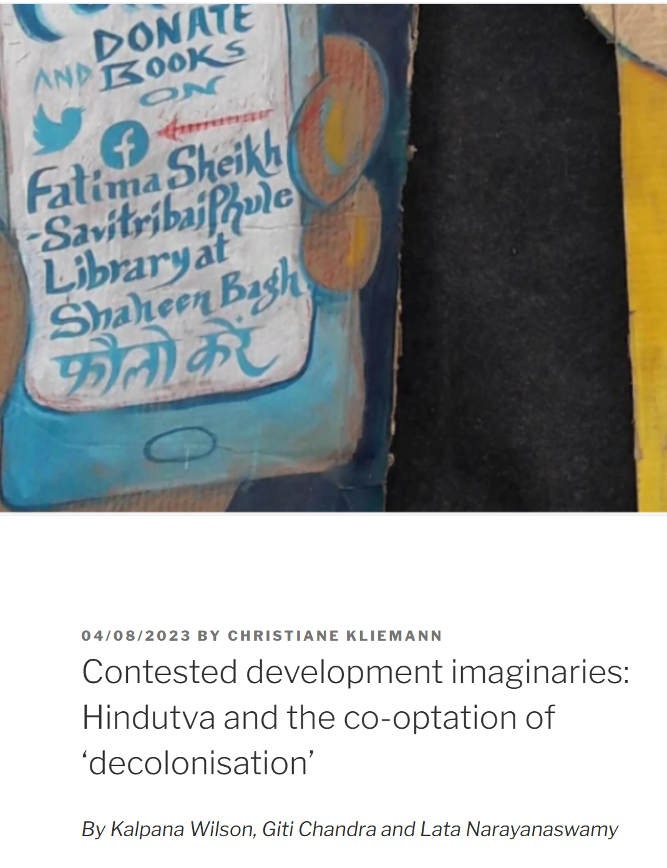
Why coloniality matters to EVERYONE … or unflattening the ‘Global South’
NEO-COLONIALISM … speaks to the fact that in the post-colonial moment, we do not only deal with just the consequences of a colonial past, but also with the continuation and reproduction - albeit more covertly – of the structures and relations of extraction, dispossession and imposition between the former colonizers and the colonized peoples … Colonization models are thus perpetuated by fellow citizens, former colonizers, and other external actors, as well as through institutions of global governance.
Atuire and Rutazibwa (2020)

Slide 4
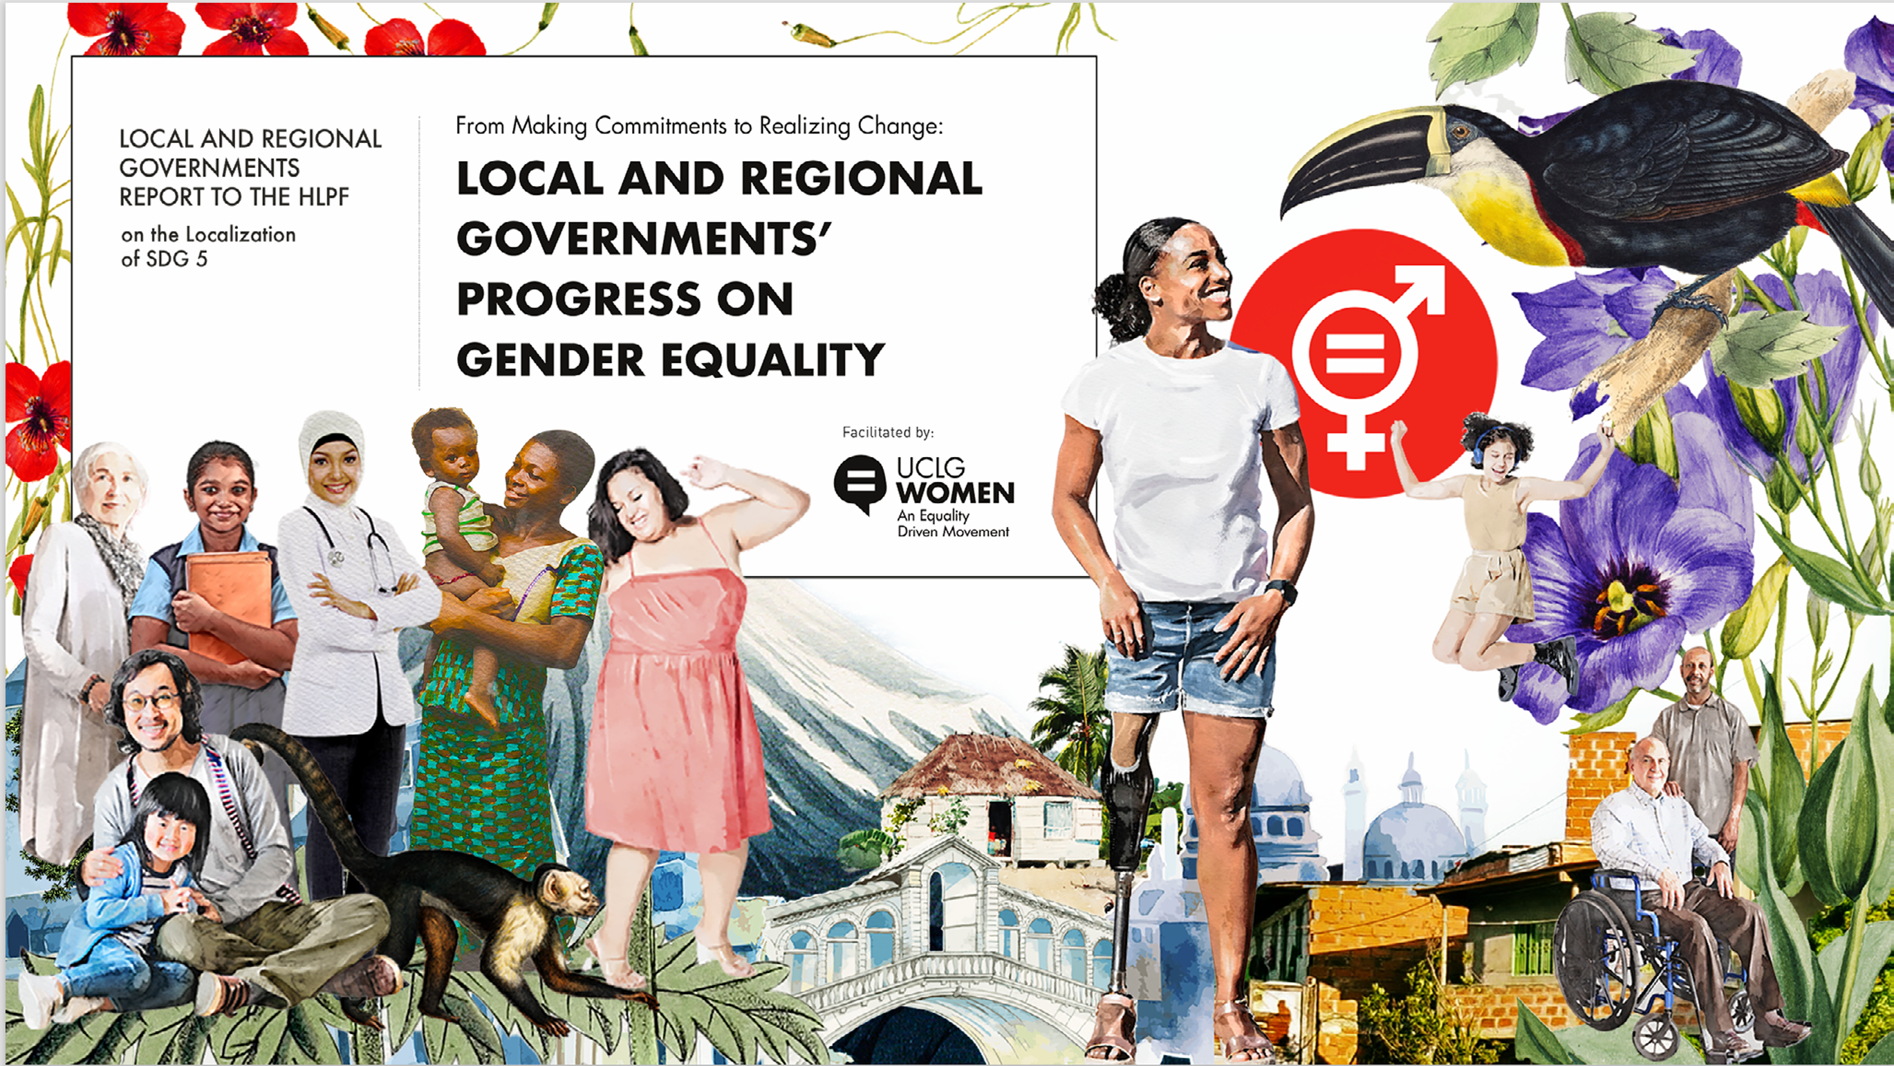
Reflecting on ‘localisation’ and ‘locally-led development’

Slide 5
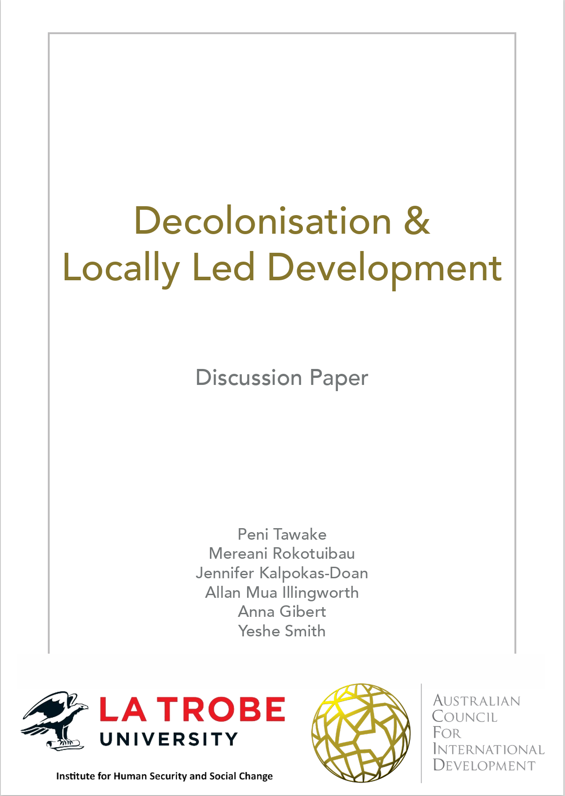
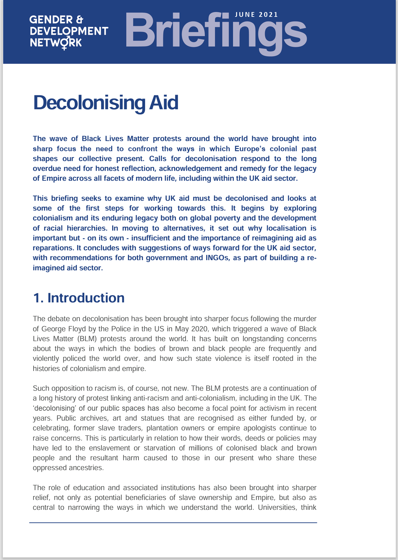
Being locally led and globally connected will mean we can have bigger, longer-lasting impacts on people’s lives. P4C-statements-2.pdf (pledgeforchange2030.org)
Localisation has also come to hold multiple meanings, with the term acting as a “container to hold the many critiques of the marginalisation of the Global South within the international humanitarian response” (Kelly et al., 2021). It is not an end, but a process to the destination of locally-led practice (Baguios et al., 2021). Zadeh-Cummings (2022) Through the looking glass: Coloniality and mirroring in localisation (deakin.edu.au)
We are referring to ‘locally led’ processes, rather than ‘localisation,’ which is more specific to the Humanitarian sector since the establishment of the Grand Bargain. Tawake et al. (2021), ACFID Decolonisation and Locally Led Development Discussion Paper
If the charge is that the North holds all the power – of resources and ideas, thus shaping systems in ways that reproduce colonial logics – then decentralising aid to national and/or local actors might be perceived as a way for Southern-based actors to re-imagine development ideas ‘in a way that is most suitable for the context in which they work’. Narayanaswamy et al. (2021) Decolonising Aid Briefing

Slide 6
To decolonise we MUST localise …?

Slide 7
But where is the local?
The local is not homogenous
Re-homogenises ‘black and brown others’ as indistinguishable
Structures of aid intact
‘The concept of locally-led; cannot be reduced to nationality or geographical location. Local actors operate on a range of levels – community, sub-national and national … Supporting locally-led approaches means acknowledging that local communities are never homogenous, often espouse divergent views and are centrally involved in local politics’ (Tawake et al., 2021: 7).

Slide 8
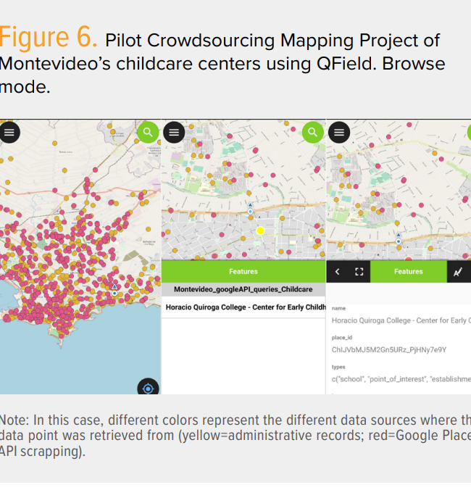
Where do we go from here? Starting the conversation …
Questions we can ask ourselves and each other:
What are the ETHICS of my activity?
Am I even the right person to be asking the question?
What happens if I change my perspective?
What if I measure something else? (eg care in Bogota)
Moving beyond ‘us’ and ‘them’ to just US!

